Slide 1

SafeDrones: Real-Time Reliability Evaluation of UAVs using Executable Digital Dependable Identities
Koorosh Aslansefat, Panagiota Nikolaou, Martin Walker, Mohammed Naveed Akram, Ioannis Sorokos, Jan Reich, Panayiotis Kolios, Maria K. Michael, Theocharis Theocharides, Georgios Ellinas, Daniel Schneider and Yiannis Papadopoulos
k.aslansefat@hull.ac.uk

Slide 2


















Table of Content
Secure and Safe Multi-Robot Systems
Funding: H2020-ICT-2020-2
Duration: 3 Years, Starting from January 1st, 2021
17 Partners
~ 7M € Budget
Coordination by The Open Group Limited

Slide 3
Table of Content
What we are going to discuss
Introduction
Brief introduction for drones and the importance of reliability evaluation
SafeDrones, Markov Modelling
SafeDrones Goals, Markov modelling of drones with different configurations, simplification of models
Numerical Results
Numerical results for reliability and MTTF
Conclusion
A conclusion and suggestions for future works

Slide 4


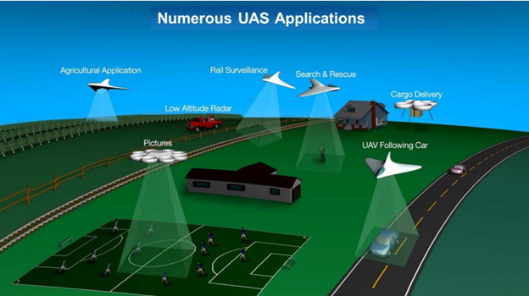
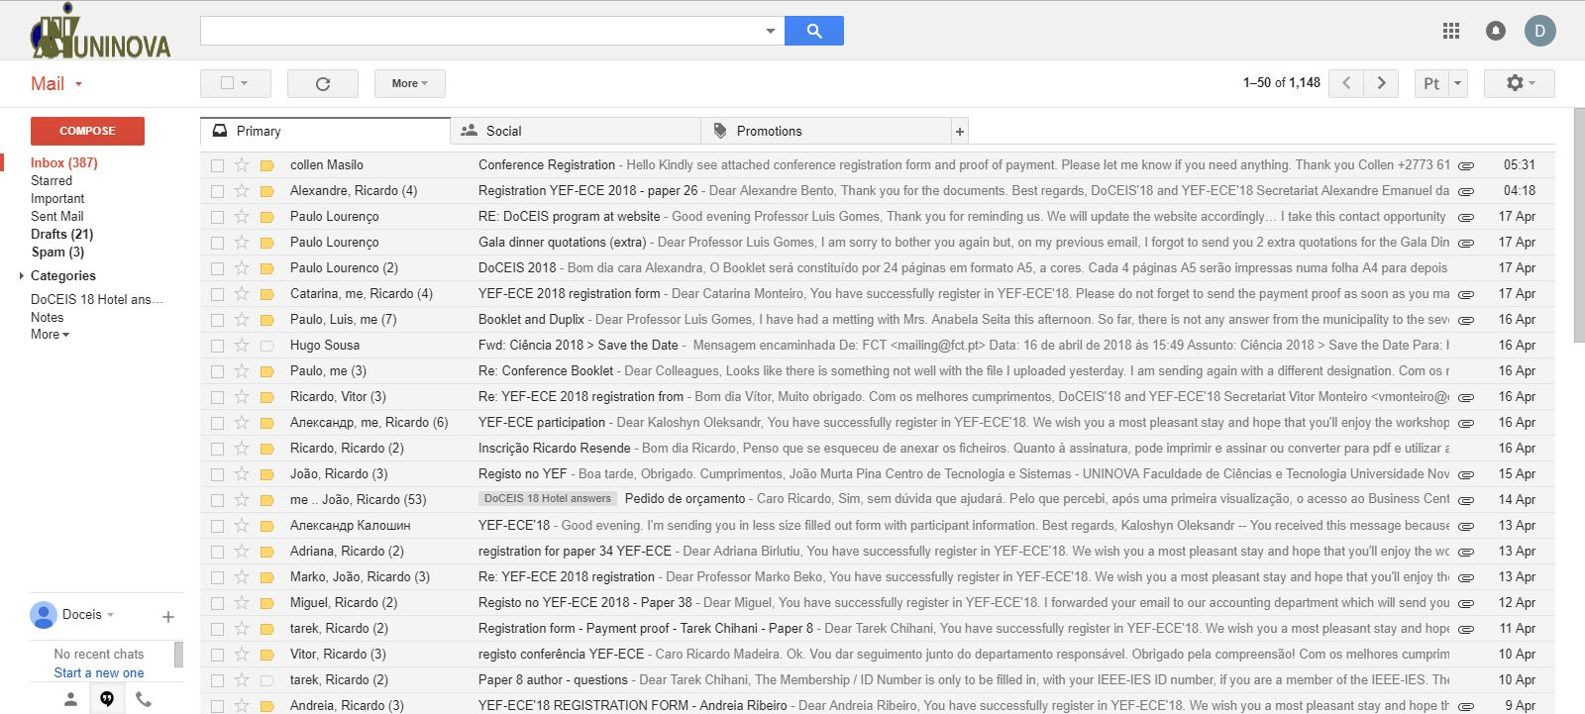
Applications of Drones
UAV Applications
Agricultural
Cargo Delivery
Search and Rescue
Entertainment
[3]

Slide 5
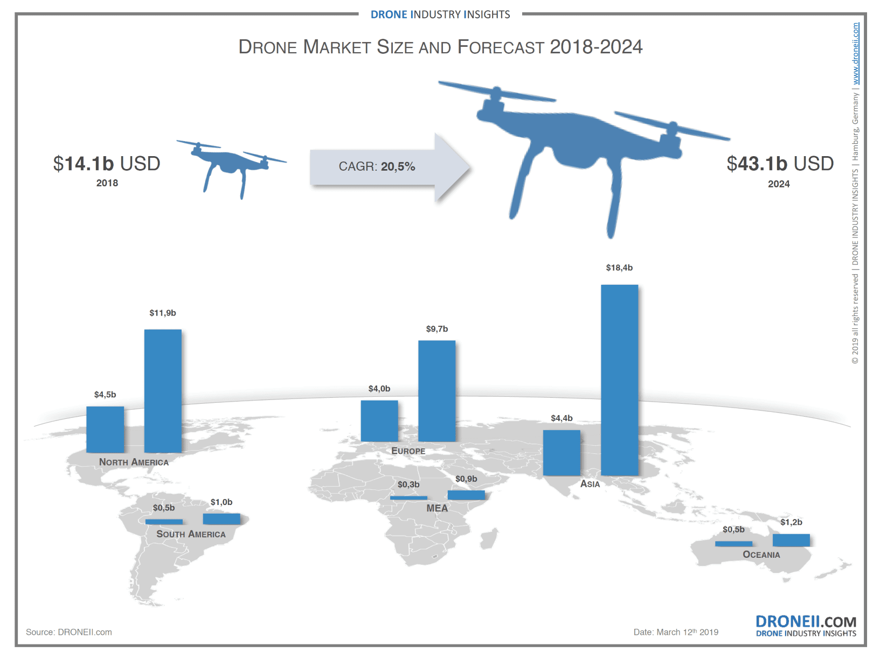
Drones Market
A quick report
Reference: www.droneii.com

Slide 6
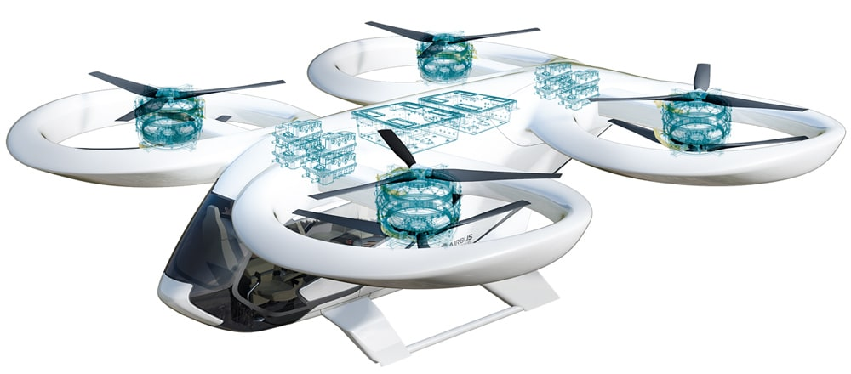
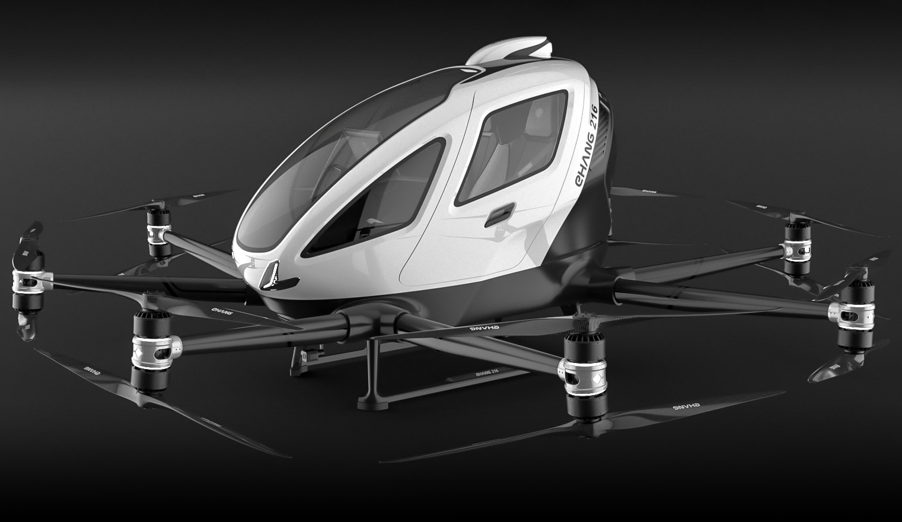
UAV-like eVTOLs
Airbus Air Taxi
EHANG 216
Reference: www.evtol.com

Slide 7
Background

Slide 8

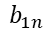


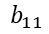




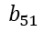



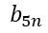
A Simple Structure of Hidden Markov Model
$$F_{4}\left(t\right)$$
Hidden States
of System’s
Operation
$$F_{3}\left(t\right)$$
$$F_{3}\left(t\right)$$
$$F_{2}\left(t\right)$$
$$F_{2}\left(t\right)$$
$$F_{2}\left(t\right)$$
$$F_{1}\left(t\right)$$
$$F_{1}\left(t\right)$$
$$F_{1}\left(t\right)$$
$$F_{1}\left(t\right)$$
OP
D1
D2
D3
F
$$b_{1n}$$
$$b_{51}$$
$$b_{11}$$
$$b_{5n}$$
System’s
Observations
O1
O2
O3
O4
O5
On

Slide 9

Merging the Idea of Hidden Markov Model with DFT
TOP
$$PAND$$
Hidden Model
A
B
Abnormal
Temperature
Abnormal
Vibration
Abnormal
Displacement
$$⋯$$
Abnormal
Condition n
Observations
© K. Aslansefat, 2018

Slide 10
Sliding Window-based Diagnostic and Prognostic
Sliding Window #1
W1
W2
W3
Wn
n operating points
L
l
Window Length
Window Overlaps

Slide 11















A Basic Event in DFT and Phased Type Markov Model
TOP
$$F_{2}\left(t\right)$$
N = 2
$$F_{1}\left(t\right)$$
$$F_{1}\left(t\right)$$
$$PAND$$
OP
D1
F
$$F_{3}\left(t\right)$$
A
B
$$F_{2}\left(t\right)$$
$$F_{2}\left(t\right)$$
N = 3
Convert the model to a Acyclic Phased-Type Markov model
$$F_{1}\left(t\right)$$
$$F_{1}\left(t\right)$$
$$F_{1}\left(t\right)$$
OP
D1
D2
F
A
$$F_{A}\left(t\right)$$
A
F
N = 4
$$F_{4}\left(t\right)$$
$$F_{3}\left(t\right)$$
$$F_{3}\left(t\right)$$
$$F_{B}\left(t\right)$$
$$F_{2}\left(t\right)$$
$$F_{2}\left(t\right)$$
$$F_{2}\left(t\right)$$
B
B
F
$$F_{1}\left(t\right)$$
$$F_{1}\left(t\right)$$
$$F_{1}\left(t\right)$$
$$F_{1}\left(t\right)$$
OP
D1
D2
D3
F
Trivedi, K., & Bobbio, A. (2017). Phase-Type Expansion. In Reliability and Availability Engineering: Modelling, Analysis, and Applications (pp. 551-574). Cambridge: Cambridge University Press. doi:10.1017/9781316163047.020

Slide 12
Sliding Window-based Diagnostic and Prognostic
TOP
$$PAND$$
OP
D1
D2
D3
F
A
B
OP
D1
D2
D3
F
Calculating the Probability to Failure and also Mean Time To Failure (MTTF)
OP
D1
D2
D3
F
OP
D1
D2
D3
F
OP
D1
D2
D3
F

Slide 14

SafeDrones Project Goal
Reliability and Safety Modelling
Providing safety and reliability models for different parts of Drones.
Safety and Reliability Monitoring
Online safety and reliability monitoring of Drones.
EDDI: Executable Digital Dependable Identifier
Providing EDDI functions to be executed on robot embedded system.
https://github.com/koo-ec/SafeDrones
© K. Aslansefat, 2021

Slide 15
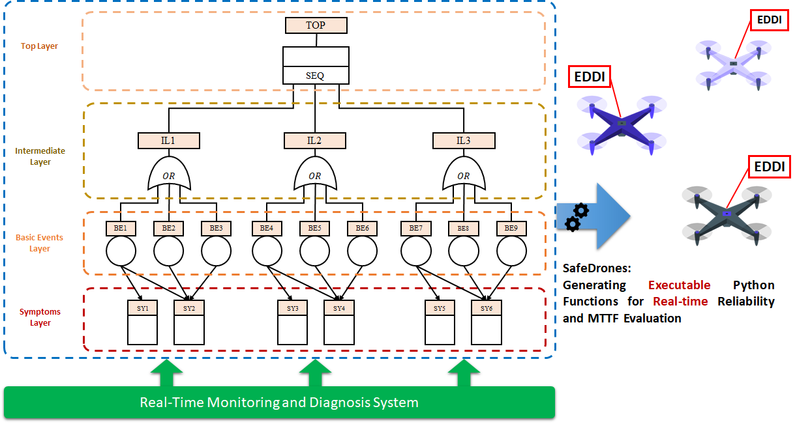

Slide 16
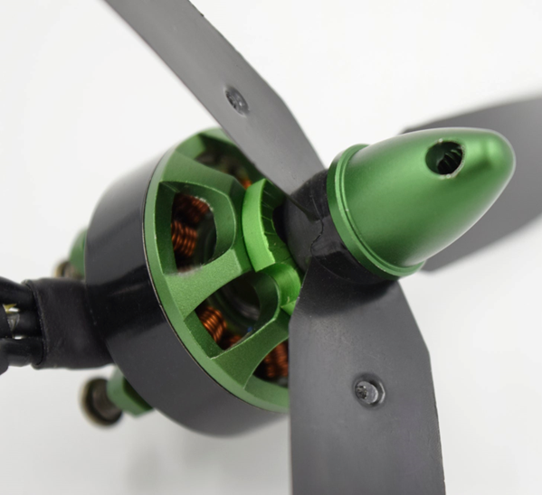
Propulsion System

Slide 17
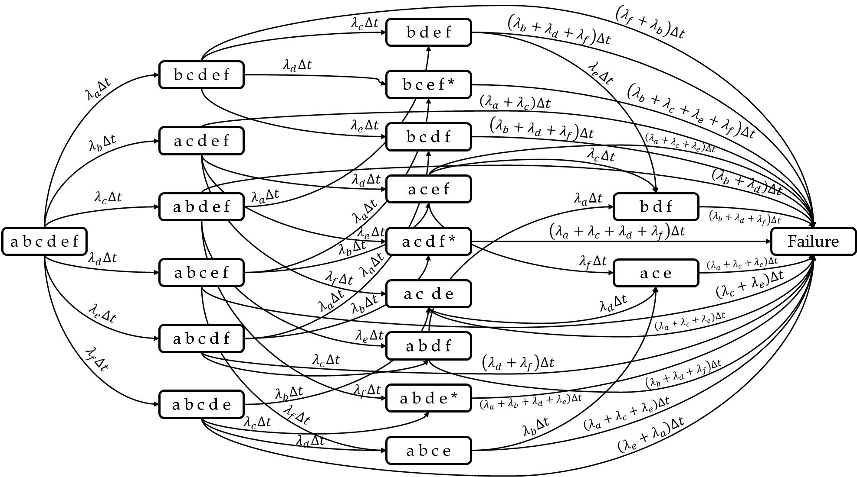
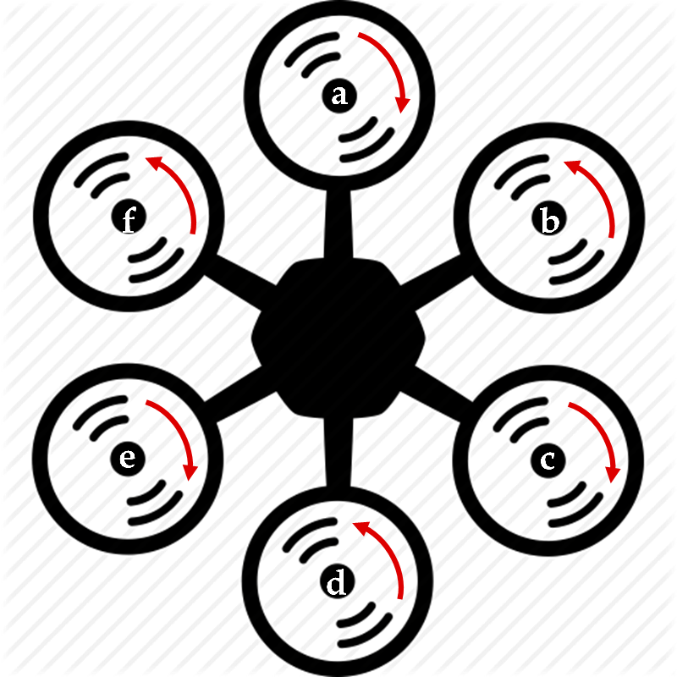
Markov Modelling
Hexa-Copter PNPNPN Configuration
Aslansefat, K., Marques, F., Mendonça, R., & Barata, J. (2019, May). A Markov process-based approach for reliability evaluation of the propulsion system in multi-rotor drones. In Doctoral Conference on Computing, Electrical and Industrial Systems (pp. 91-98). Springer.

Slide 18
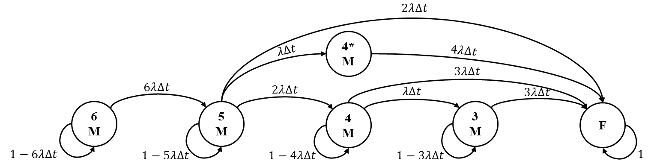
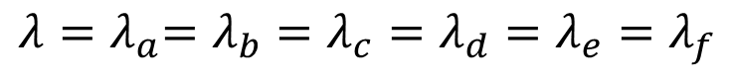
Simplified Markov Model
Hexa-Copter PNPNPN Configuration
$$λ{=λ}_{a}=λ_{b}=λ_{c}=λ_{d}=λ_{e}=λ_{f}$$
Aslansefat, K., Marques, F., Mendonça, R., & Barata, J. (2019, May). A Markov process-based approach for reliability evaluation of the propulsion system in multi-rotor drones. In Doctoral Conference on Computing, Electrical and Industrial Systems (pp. 91-98). Springer.

Slide 19
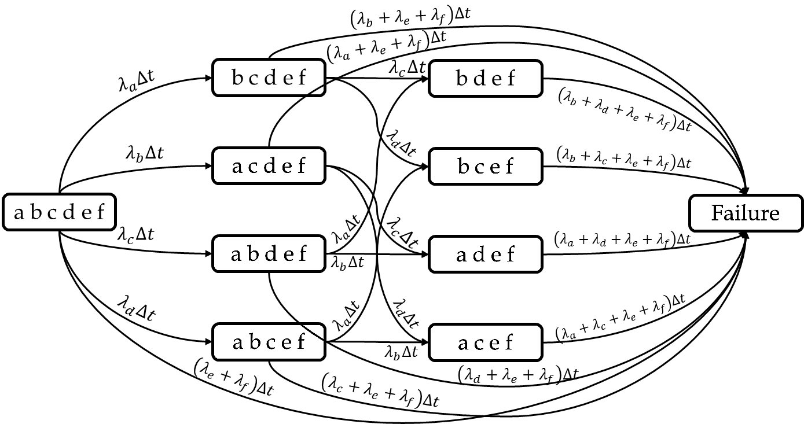
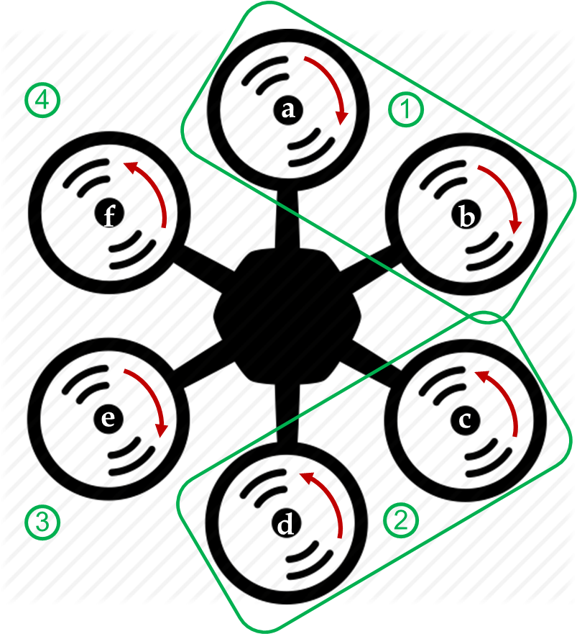
Markov Modelling
Hexa-Copter PPNNPN Configuration
Aslansefat, K., Marques, F., Mendonça, R., & Barata, J. (2019, May). A Markov process-based approach for reliability evaluation of the propulsion system in multi-rotor drones. In Doctoral Conference on Computing, Electrical and Industrial Systems (pp. 91-98). Springer.

Slide 20
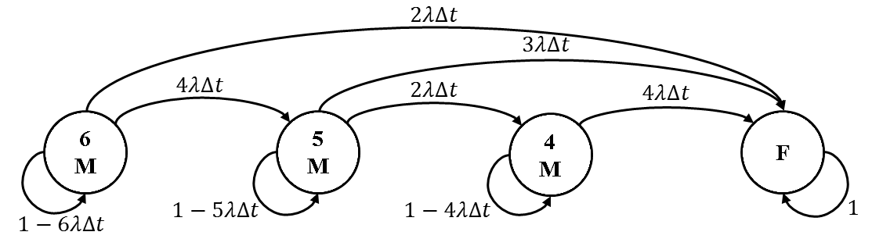
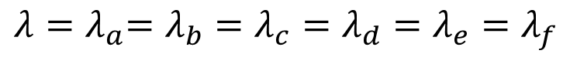
Simplified Markov Model
Hexa-Copter PPNNPN Configuration
$$λ{=λ}_{a}=λ_{b}=λ_{c}=λ_{d}=λ_{e}=λ_{f}$$
Aslansefat, K., Marques, F., Mendonça, R., & Barata, J. (2019, May). A Markov process-based approach for reliability evaluation of the propulsion system in multi-rotor drones. In Doctoral Conference on Computing, Electrical and Industrial Systems (pp. 91-98). Springer.

Slide 21
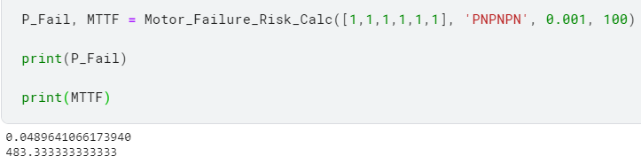

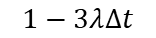

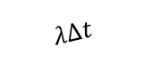
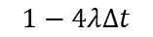

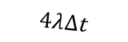
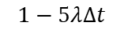

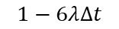


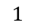
$$2λ∆t$$
4*
M
$$λ∆t$$
$$4λ∆t$$
$$3λ∆t$$
$$6λ∆t$$
$$2λ∆t$$
$$λ∆t$$
$$3λ∆t$$
6
M
5
M
4
M
3
M
F
$$1−6λ∆t$$
$$1−5λ∆t$$
$$1−4λ∆t$$
$$1−3λ∆t$$
$$1$$
© K. Aslansefat, 2021

Slide 22
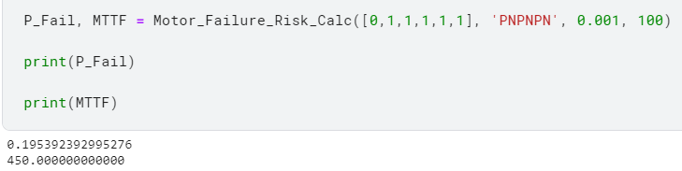
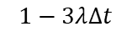

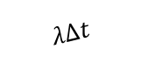
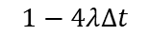


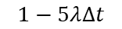

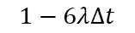

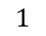
$$2λ∆t$$
4*
M
$$λ∆t$$
$$4λ∆t$$
$$3λ∆t$$
$$6λ∆t$$
$$2λ∆t$$
$$λ∆t$$
$$3λ∆t$$
6
M
5
M
4
M
3
M
F
$$1−6λ∆t$$
$$1−5λ∆t$$
$$1−4λ∆t$$
$$1−3λ∆t$$
$$1$$
© K. Aslansefat, 2021

Slide 23
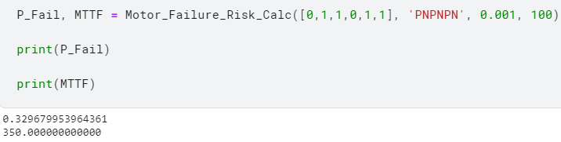

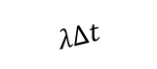

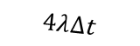


$$2λ∆t$$
4*
M
$$λ∆t$$
$$4λ∆t$$
$$3λ∆t$$
$$6λ∆t$$
$$2λ∆t$$
$$λ∆t$$
$$3λ∆t$$
6
M
5
M
4
M
3
M
F
$$1−6λ∆t$$
$$1−5λ∆t$$
$$1−4λ∆t$$
$$1−3λ∆t$$
$$1$$
© K. Aslansefat, 2021

Slide 24
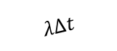

$$2λ∆t$$
4*
M
$$λ∆t$$
$$4λ∆t$$
$$3λ∆t$$
$$6λ∆t$$
$$2λ∆t$$
$$λ∆t$$
$$3λ∆t$$
6
M
5
M
4
M
3
M
F
$$1−6λ∆t$$
$$1−5λ∆t$$
$$1−4λ∆t$$
$$1−3λ∆t$$
$$1$$
© K. Aslansefat, 2021

Slide 25
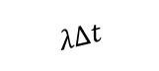


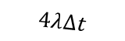



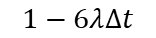

$$2λ∆t$$
4*
M
$$λ∆t$$
$$4λ∆t$$
$$3λ∆t$$
$$6λ∆t$$
$$2λ∆t$$
$$λ∆t$$
$$3λ∆t$$
6
M
5
M
4
M
3
M
F
$$1−6λ∆t$$
$$1−5λ∆t$$
$$1−4λ∆t$$
$$1−3λ∆t$$
$$1$$
$$0$$
$$1$$
$$0$$
$$0$$
$$0$$
$$0$$
M_S
PNPNPN Configuration

Slide 26

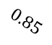
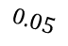
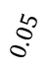
$$2λ∆t$$
4*
M
$$λ∆t$$
$$4λ∆t$$
$$3λ∆t$$
$$6λ∆t$$
$$2λ∆t$$
$$λ∆t$$
$$3λ∆t$$
6
M
5
M
4
M
3
M
F
$$1−6λ∆t$$
$$1−5λ∆t$$
$$1−4λ∆t$$
$$1−3λ∆t$$
$$1$$
$$0.05$$
$$0.85$$
$$0.05$$
$$0.05$$
$$0$$
$$0$$
M_S
PNPNPN Configuration

Slide 27
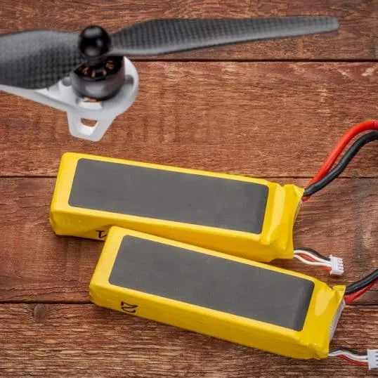
Battery System
27

Slide 28
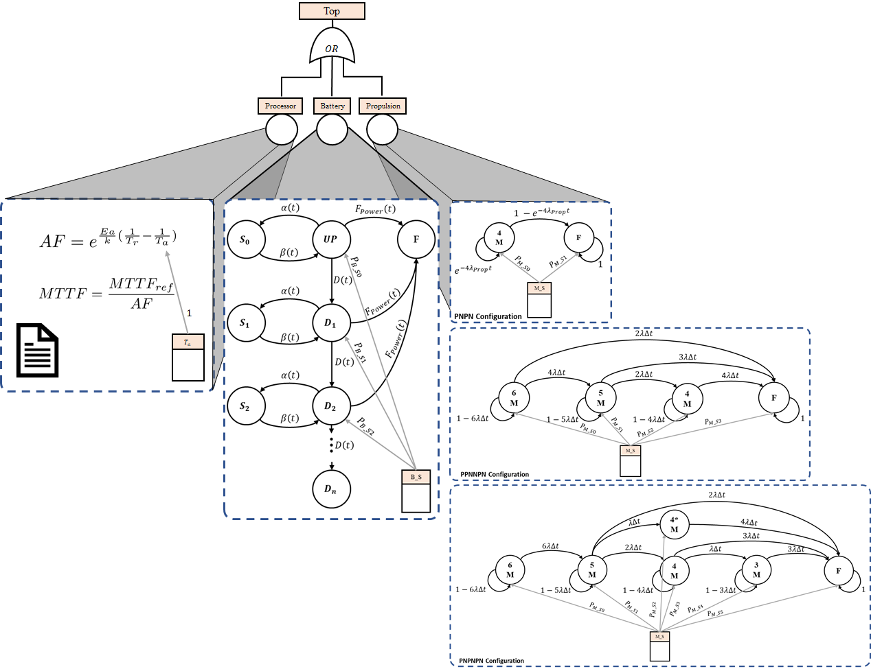
Battery System Degradation and Failure
Kabir, S., Aslansefat, K., Sorokos, I., Papadopoulos, Y., & Gheraibia, Y. (2019, October). A conceptual framework to incorporate complex basic events in HiP-HOPS. In International Symposium on Model-Based Safety and Assessment (pp. 109-124). Springer.

Slide 29
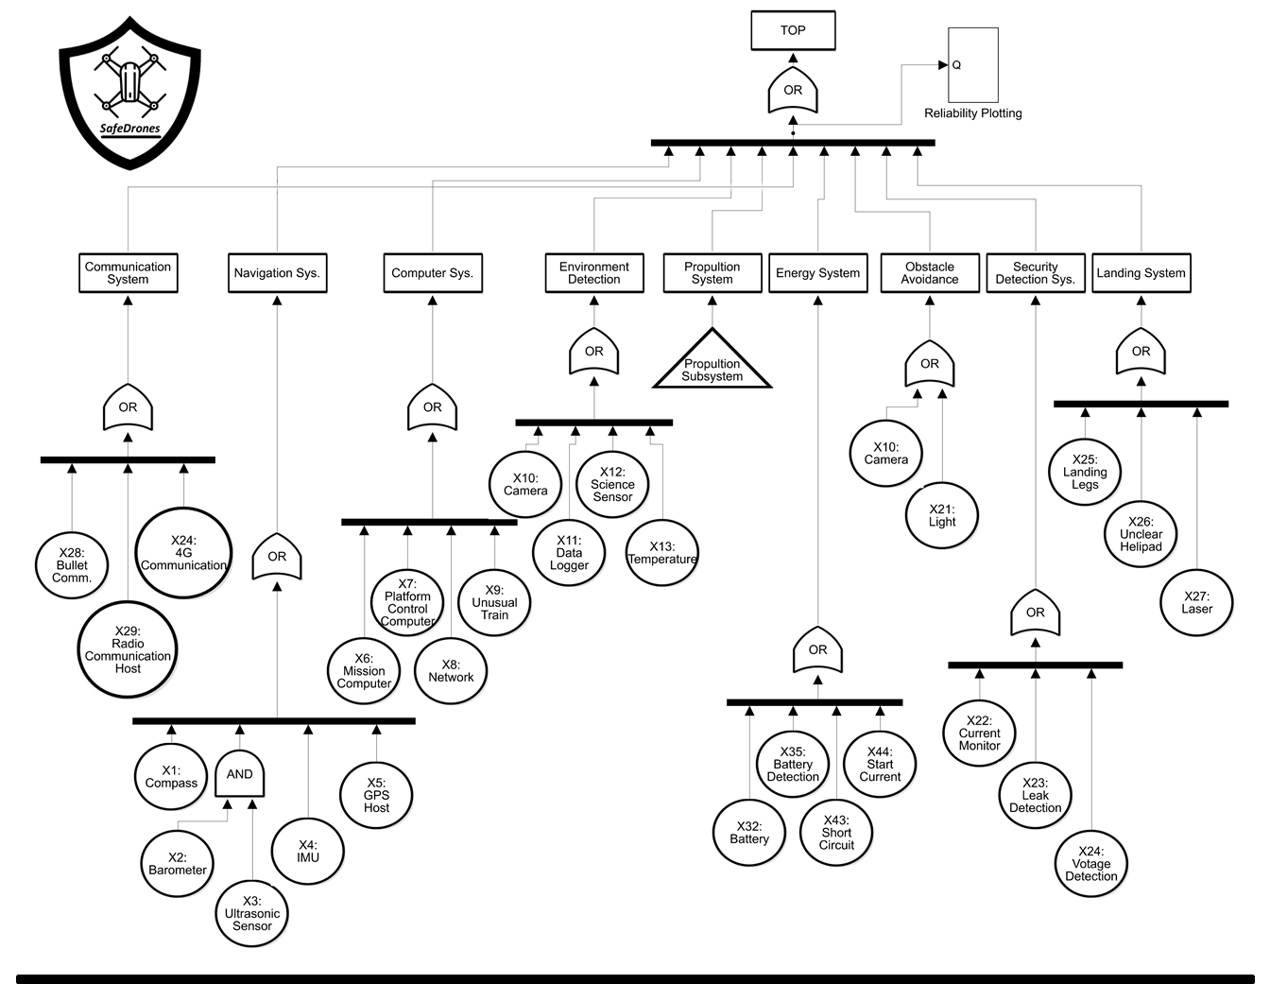

Slide 30
Arrhenius Equation
(Ottavi, M. et al., 2014)

Slide 31
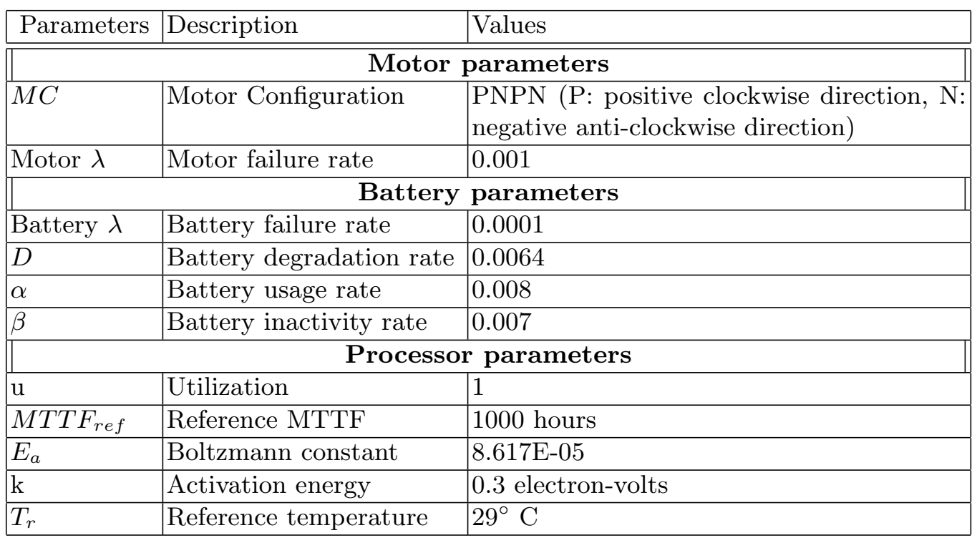

Slide 32
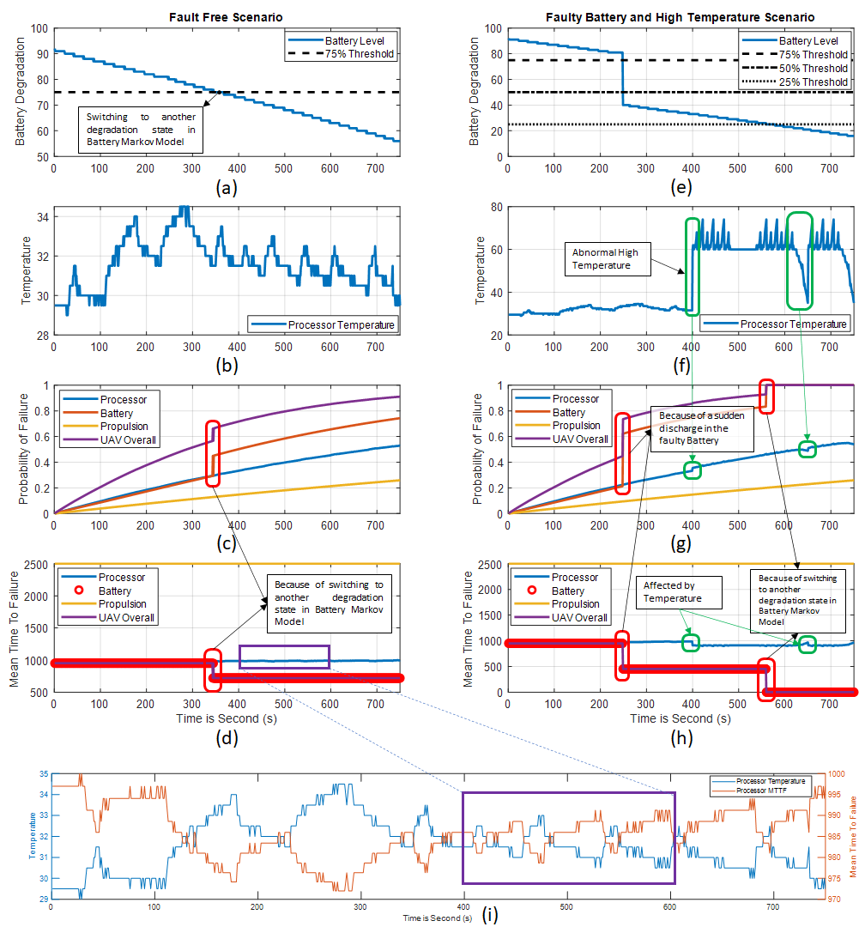

Slide 33
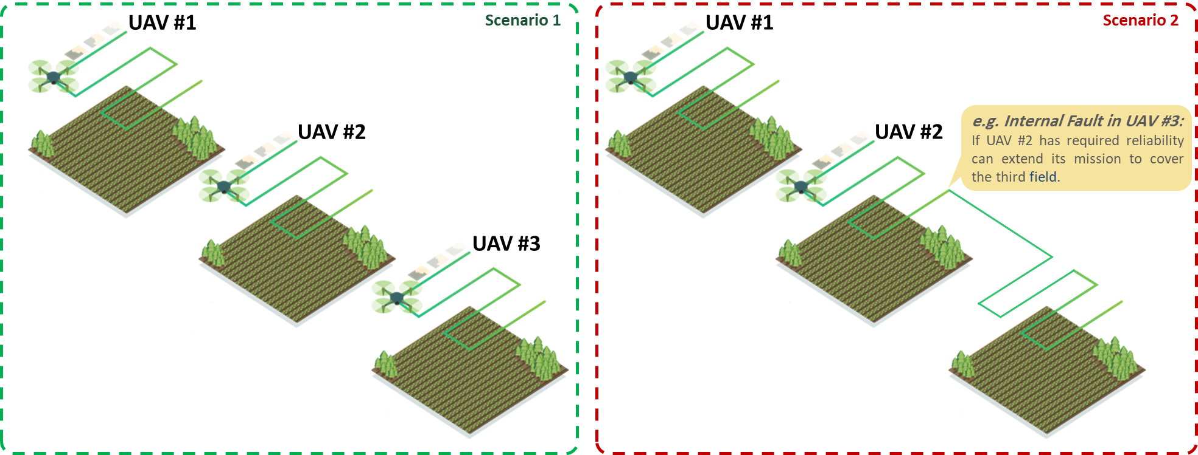
Application of SafeDrones for Multi-robot Precision Agriculture
Consider a scenario in which three UAVs are tasked to scan three fields in parallel when an internal fault occurs in UAV #3. Although it does not cause immediate failure, SafeDrones re-evaluates the reliability at runtime and determines it increases the risk above a dangerous threshold, so in order to reduce the risk of collision or spraying out of bounds, UAV #3 activates a fail-safe mechanism and returns to base. If UAV #2 has required availability, its mission can then be updated to cover the third field.
© K. Aslansefat, 2022

Slide 34



Application of SafeDrones for Offshore Wind Turbine Blade Inspection
Considering the widely variable wind speeds encountered, a fault in the UAV that reduces controllability risks collision with a blade, causing damage to both UAV and wind turbine. The SafeDrones approach allows us to assess risk in real-time in response to the occurrence of faults by providing a runtime evaluation of reliability. Using this information, the drone can adapt its behaviour accordingly, e.g. by increasing safe distance to reduce risk of collision.
e.g. - Motor Failure:
Updating the Reliability Profile and Required Safe Distance
Safe Distance
Unsafe Distance
© K. Aslansefat, 2022

Slide 35


Slide 36


Slide 37

© KIOS 2022

Slide 38
Conclusion
To help address the problems of UAV reliability and risk assessment, particularly at runtime where operational and environmental factors are hard to predict, the SafeDrones reliability modelling approach has been proposed.
It employs a combination of FTA with CBEs to support real-time reliability evaluation as a prototype of the EDDI concept.
It introduces a novel symptoms layer in Fault Tree Analysis to integrate it with runtime monitoring data.
To illustrate SafeDrones, we applied it to a power network inspection use case to show how real-time reliability evaluation can be used to anticipate imminent failures and prevent accidents by recommending appropriate responses.

Slide 39


Future Works
DDI
Environment Information
e.g., Wind Speed and Direction
SafeDrones
Updating Reliability Profile
ConSerts
Providing Safety Guarantees
Final Decisions
e.g., Aborting mission and
Emergency Landing

Slide 40
References
[1] Trivedi, K., & Bobbio, A. (2017). Phase-Type Expansion. In Reliability and Availability Engineering: Modelling, Analysis, and Applications (pp. 551-574). Cambridge: Cambridge University Press.
[2] Aslansefat, K., Marques, F., Mendonça, R., & Barata, J. (2019, May). A markov process-based approach for reliability evaluation of the propulsion system in multi-rotor drones. In Doctoral Conference on Computing, Electrical and Industrial Systems (pp. 91-98). Springer.
[3] Kabir, S., Aslansefat, K., Sorokos, I., Papadopoulos, Y., & Gheraibia, Y. (2019, October). A conceptual framework to incorporate complex basic events in HiP-HOPS. In International Symposium on Model-Based Safety and Assessment (pp. 109-124). Springer.
[4] Ottavi, M., Pontarelli, S., Gizopoulos, D., Bolchini, C., Michael, M.K., Anghel, L., Tahoori, M., Paschalis, A., Reviriego, P., Bringmann, O., et al.: Dependable multicore architectures at nanoscale: The view from europe. IEEE Design & Test, 32(2), 17–28 (2014).
[5] Armengaud, E., Schneider, D., Reich, J., Sorokos, I., Papadopoulos, Y., Zeller, M., ... & Kabir, S. (2021, February). DDI: A novel technology and innovation model for dependable, collaborative and autonomous systems. In 2021 Design, Automation & Test in Europe Conference & Exhibition (DATE) (pp. 1626-1631).

Slide 41


Thanks for Your Attention
If you have any question, please feel free to ask

Slide 44
GPS Failure

Slide 46
0.9
No Failure
0.88
One Motor Failure without Uncertainty
One Motor Failure with 30% Uncertainty
0.86
One Motor Failure with 50% Uncertainty
e
r
0.84
u
l
i
a
F
0.82
f
o
y
t
i
0.8
l
i
b
a
b
o
0.78
r
P
0.76
0.74
0.72
100
110
120
130
140
150
160
170
180
190
200
Time

